Slide 1
TIS Solutions Appraisal Systems
Made by : Jyoti Bhardwaj

Slide 2
CONTENTS
WHAT IS AN APPRAISAL SYSTEM ?
HOW IT WORKS ?
DESCRIPTION
FLOW CHART
TABLES MADE
SNIPPETS FROM THE CODE
OUTPUT
END SLIDE

Slide 3
WHAT IS AN APPRAISAL SYSTEM ?
Appraisal System is a major tool to measure employees’ performance. It is a great way to provide regular, formal employee performance reviews, progress, and development plans. They can drive high performance, enable career progression and promote skill development through ongoing feedback and support.
Appraisal systems measure employee performance against previously-agreed goals, set future objectives and give staff guidance on their developmental and training needs. They help managers identify both achievements and shortfalls in performance, and give a framework to guide future improvements.

Slide 4
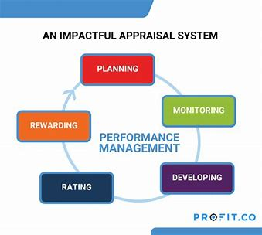
HOW AN APPRAISAL SYSTEM WORKS?

Slide 5
DESCRIPTION:
TIS Solutions has great work with their employees, with this in TIS Solutions they have increasing number of employees.
TIS solutions has a conflict about the employees and their accomplishments. It will implement appraisal strategies to keep the motivational and performance level of their employees high. So, they want to implement this Appraisal System.
In the EMPLOYEE APPRAISAL APP all employees can know their performance with employee appraisal app. This performance can be given in yearly, half-yearly, or quarterly to their employees. This will help the employees to grow up and enhance skills with appraisal. This Appraisal module allows you to create top-down or bottom-up evaluation plans and give timely feedback and compliments for accomplishments. By knowing all their performances employees will know all their accomplishments and they can perform better next time.

Slide 6
LET’S BE CLEAR:
TIS SOLUTIONS
HR
IT
ACCOUNTS
10 emp
10 emp
10 emp

Slide 7
MAKING TABLES
Three tables of three different departments are made. They are as follows :
1) HRQ
2) ITQ
3) ACQ

Slide 8
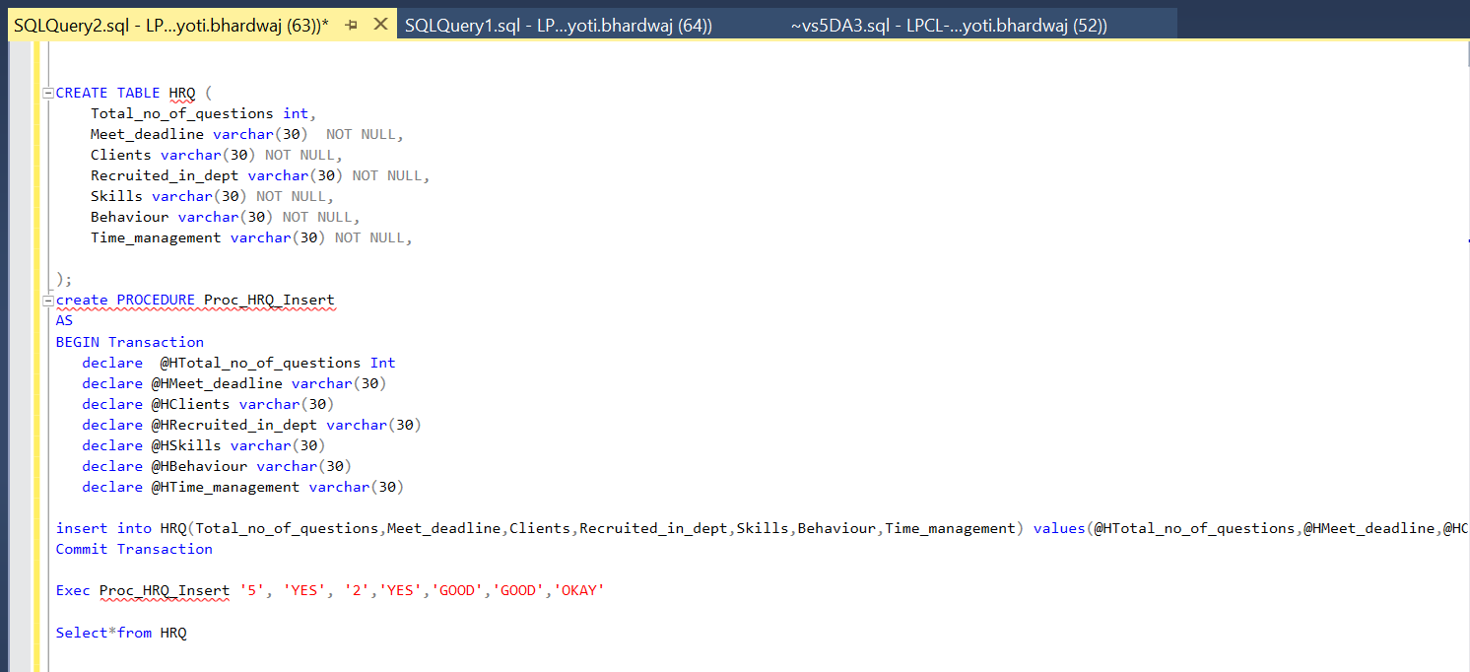
HRQ (HR QUESTIONS)

Slide 9
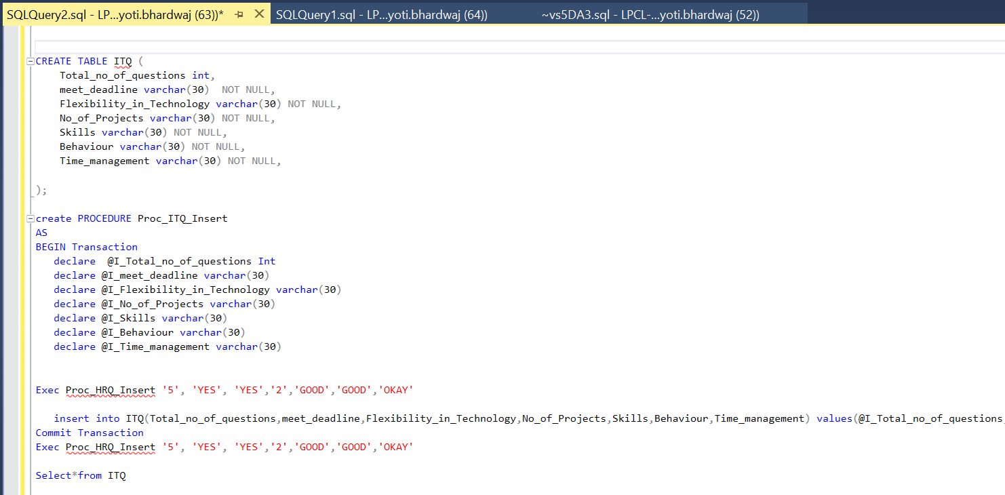
ITQ (IT QUESTIONS)

Slide 10
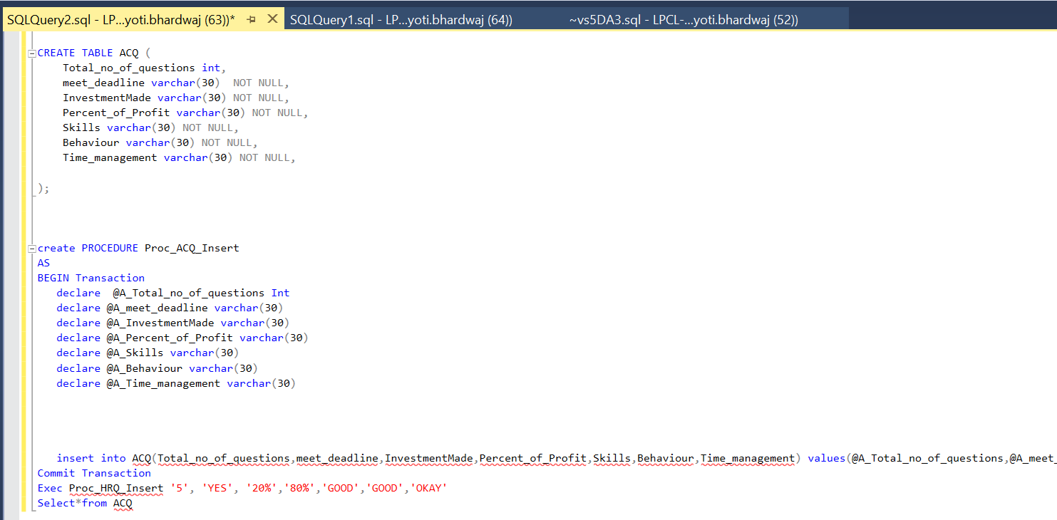
ACQ ( ACCOUNTS QUESTIONS)

Slide 11
GOT ANY QUERIES?

Slide 12
THANK YOU

